Slide 1
AFSA’s Virtual Legislative Awareness Week October 4th - October 10th

Slide 2
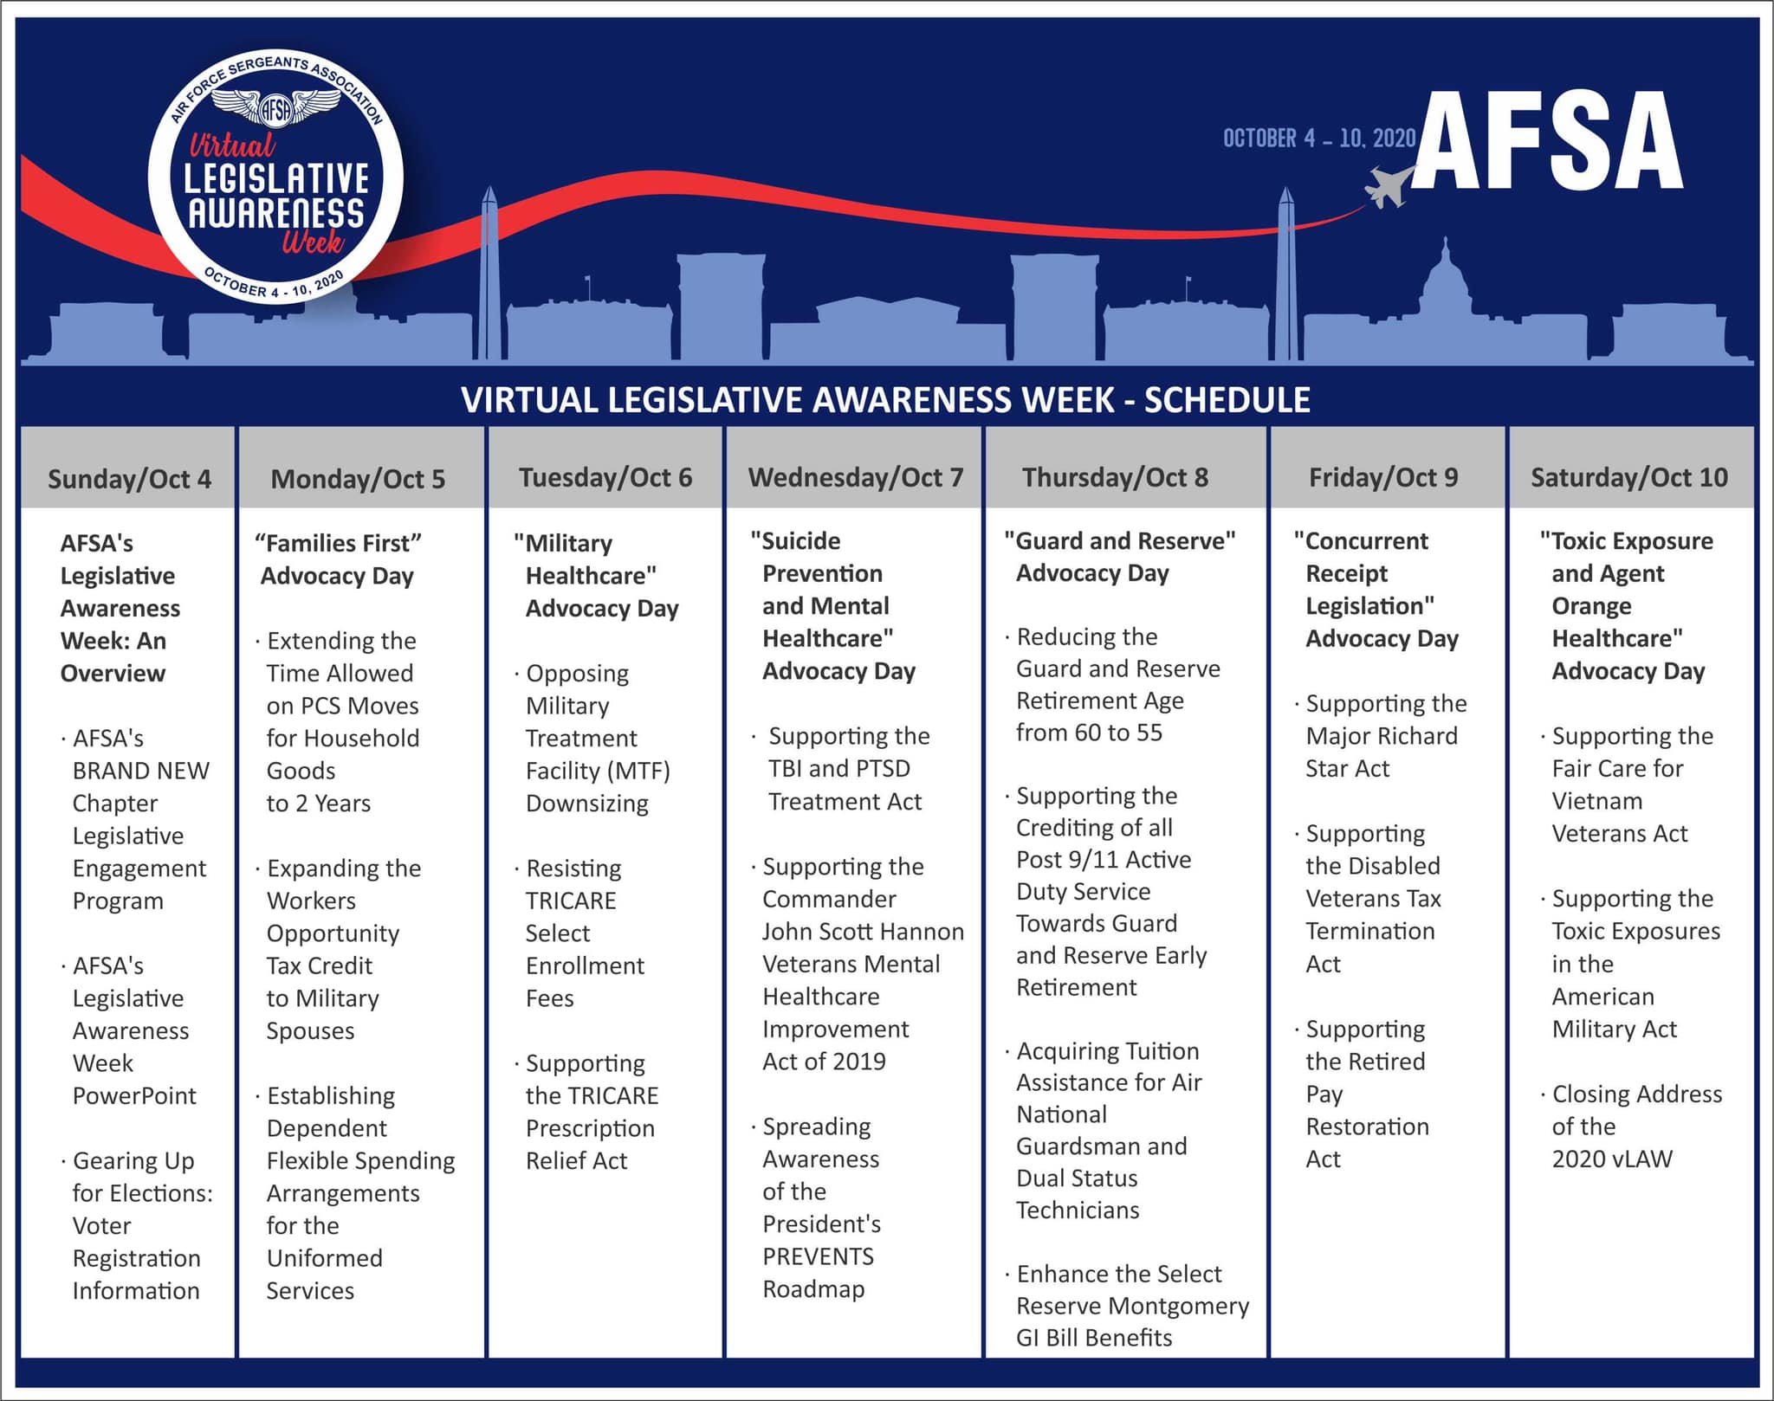
Virtual Legislative Awareness Week Schedule
Monday “Families First” Advocacy Day
Tuesday “Military Healthcare” Advocacy Day
Wednesday “Suicide Prevention and Mental Healthcare” Advocacy Day
Thursday “Guard and Reserve” Advocacy Day
Friday “Concurrent Receipt Legislation” Advocacy Day
Saturday “Toxic Exposure and Agent Orange Healthcare” Advocacy Day

Slide 3
AFSA Preamble
With reverence for God and Country, and being ever mindful of our responsibility to aid in maintaining a superior defense for our beloved country; our interest in the welfare of persons who served and are serving in the Air Force; our devotion to our fellow enlisted members and their families in fortune and distress; and our reverence for the memory of those departed; we unite to further the aims and objectives of this association.

Slide 4
AFSA Mission
To advocate improved quality-of-life and economic fairness to support the well-being of our enlisted members and their families.

Slide 5
AFSA Vision
To be the premier professional military and veteran service organization of choice for the enlisted corps and their families.

Slide 6
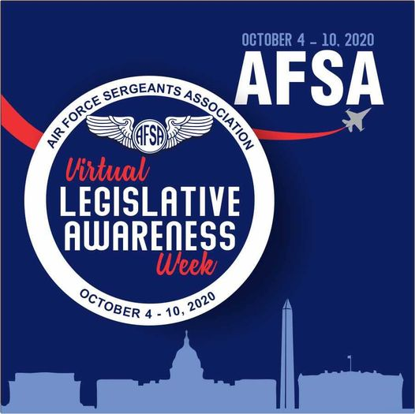
Overview of the Legislative Process
The process by which a bill becomes law is rarely predictable and can vary significantly from bill to bill. In fact, for many bills, the process will not follow the sequence of congressional stages that are often understood to make up the legislative process.
The slides that follow present a more detailed look at each of the common stages through which a bill may move, but keep in mind that complications and variations abound in practice.

Slide 7
Overview of the Legislative Process: Introduction of Bills
Bills and joint resolutions may become law if enacted during the two-year Congress in which they were introduced.
Only members of each chamber may introduce legislation, though occasionally a member introduces legislation by request of the President.
In the House, a bill is introduced when it is dropped in the hopper (a wooden box on the House floor).
In the Senate, the bill is submitted to clerks on the Senate floor. Upon introduction, the bill will receive a designation based on the chamber of introduction.
Most bills fall under the jurisdiction of one committee. If multiple committees are involved and receive the bill, each committee may work only on the portion of the bill under its jurisdiction. One of those committees will be designated the primary committee of jurisdiction and will likely take the lead on any action that may occur.
It will also receive a number, which typically is the next number available in sequence during that two-year Congress.

Slide 8
Overview of the Legislative Process: Committee Consideration
The first formal committee action on a bill or issue might be a hearing, which provides a forum at which committee members and the public can hear about the strengths and weaknesses of a proposal from selected parties.
While these hearings provide the formal public setting at which feedback is solicited on the policy proposal, committee members and staff engage in additional assessment of the approach through informal briefings and other mechanisms. Also note that a hearing is not required from a procedural standpoint for a bill to receive further action from the committee.
A committee markup is the key formal step a committee ultimately takes for the bill to advance to the floor. A markup concludes when the committee agrees, by majority vote, to report the bill to the chamber.
Most House and Senate committees establish subcommittees – subpanels of the full committee where members can further focus on specific elements of the policy area.

Slide 9
Overview of the Legislative Process: Calendars and Scheduling
When a committee has reported a bill, it is place on one of the respective chamber’s calendars. The bills on the calendars are not guaranteed floor consideration. Many will never be brought up on the floor during a two-year Congress cycle.
In the House, majority party leadership decides which bills the House will consider. Leadership may ask the Rules Committee to start the process of bringing a specific bill to the floor for more lengthy consideration and possible amendments.
The Senate can take up a bill is by agreeing to a motion to proceed to it. Once a Senator – typically the majority leader – makes such a motion that the Senate proceed to a certain bill, the Senate can then normally debate the motion to proceed. If it eventually agrees to the motion by a majority vote, the Senate can then begin consideration of the bill.
In both chambers, party leaders keep their membership informed of the anticipated floor schedule using various methods – like periodic whip notices or other frequent communications.

Slide 10
Overview of the Legislative Process: House Floor
Most bills are considered under the suspension of the rule's procedure, which limits debate to 40 minutes and does not allow amendments to be offered by members on the floor.
However, for the House to pass a bill under suspension of the rules requires two-thirds of members voting to agree, so this method is not designed for bills that do not have supermajority support in the House. Special rules are reported by the House Rules Committee.
After the Rules Committee reports a rule for consideration of a bill, the House first considers that special rule itself on the House floor, for approximately one hour. After debate, the House votes on adopting the special rule. Only after its adoption will the House proceed to consider the bill itself, under the terms specified by the special rule.
Once all amendments are offered and debated, members vote on approval, and each amendment requires a simple majority to be agreed to. After the amendment process is complete, the Committee of the Whole rises and reports to the full House any recommended amendments, which are then usually approved by the House by voice vote.

Slide 11
Overview of the Legislative Process: Senate Floor
For the Senate to consider a bill they must first agree to bring it up, usually by agreeing to a unanimous consent request or by voting to adopt a motion to proceed to the bill. Only once the Senate has agreed to consider a bill may Senators propose amendments to it.
Senate rules provide no way for a simple numerical majority to cut off or otherwise impose a debate limit and move to a final vote. As a result, Senators can effectively wage (or threaten to wage) a filibuster – in effect, insist on extended debate in order to delay or prevent a final vote on most amendments, bills, or other motions.
This final vote requires only a simple majority for approval. But because a cloture process is often required to end debate on a bill, then the bill first must garner the support of a three-fifths supermajority. All told, this process of reaching a final vote on a bill can require about a week of Senate floor time to complete.
Such an agreement is a structured plan for limiting debate and amending – a plan that can be tailored to each bill that comes to the floor (somewhat akin to a special rule in the House). Using these agreements, the details of which all Senators have agreed upon, the Senate can more effectively process its business while protecting the procedural rights of each of its members.

Slide 12
Overview of the Legislative Process: Resolution
A bill must be agreed to by both chambers in the same form before it can be presented to the President.
Once one chamber passes a bill, it is engrossed – that is, prepared in official form – and then sent to the other chamber.
The second chamber is often proposing, in effect, an alternative version of the bill, which may differ from the bill in minor or substantial ways. In some circumstances, the alternative may even embody a proposal on a different topic. Once the second chamber agrees to this proposed alternative to the bill, it may send the proposal back to the first chamber for possible consideration and a vote. The receiving chamber may also respond with a counterproposal, and so on.
For the bill to move to the next step in becoming law requires both chambers to agree to the conference report without changes.

Slide 13
Overview of the Legislative Process: Presidential Actions
Once both chambers of Congress have each agreed to the bill, it is enrolled – that is, prepared in its final official form and then presented to the President. Beginning at midnight on the closing of the day of presentment, the President has ten days, excluding Sundays, to sign or veto the bill. If the bill is signed in that ten-day period, it becomes law. If the President declines to either sign or veto it – that is, he does not act on it in any way – then it becomes law without his signature (except when Congress has adjourned under certain circumstances).
Bills that are ultimately enacted are delivered to the Office of the Federal Register at the National Archives, assigned a public law number, and included in the next edition of the United State Statutes at Large.

Slide 14
Monday “Families First” Advocacy Day
Supporting H.R.5876, the Jobs and Childcare for Military Families Act.
This legislation would provide a work opportunity tax credit for military spouses and provide for flexible spending arrangements for childcare services for military families.
For more information, please visit
To write your elected officials, please visit
https://www.votervoice.net/AFSA/campaigns/77468/respond
Supporting S.1802, the Jobs and Childcare for Military Families Act
This legislation would provide a work opportunity tax credit for military spouses and to provide for flexible spending arrangements for childcare services for military families.

Slide 15
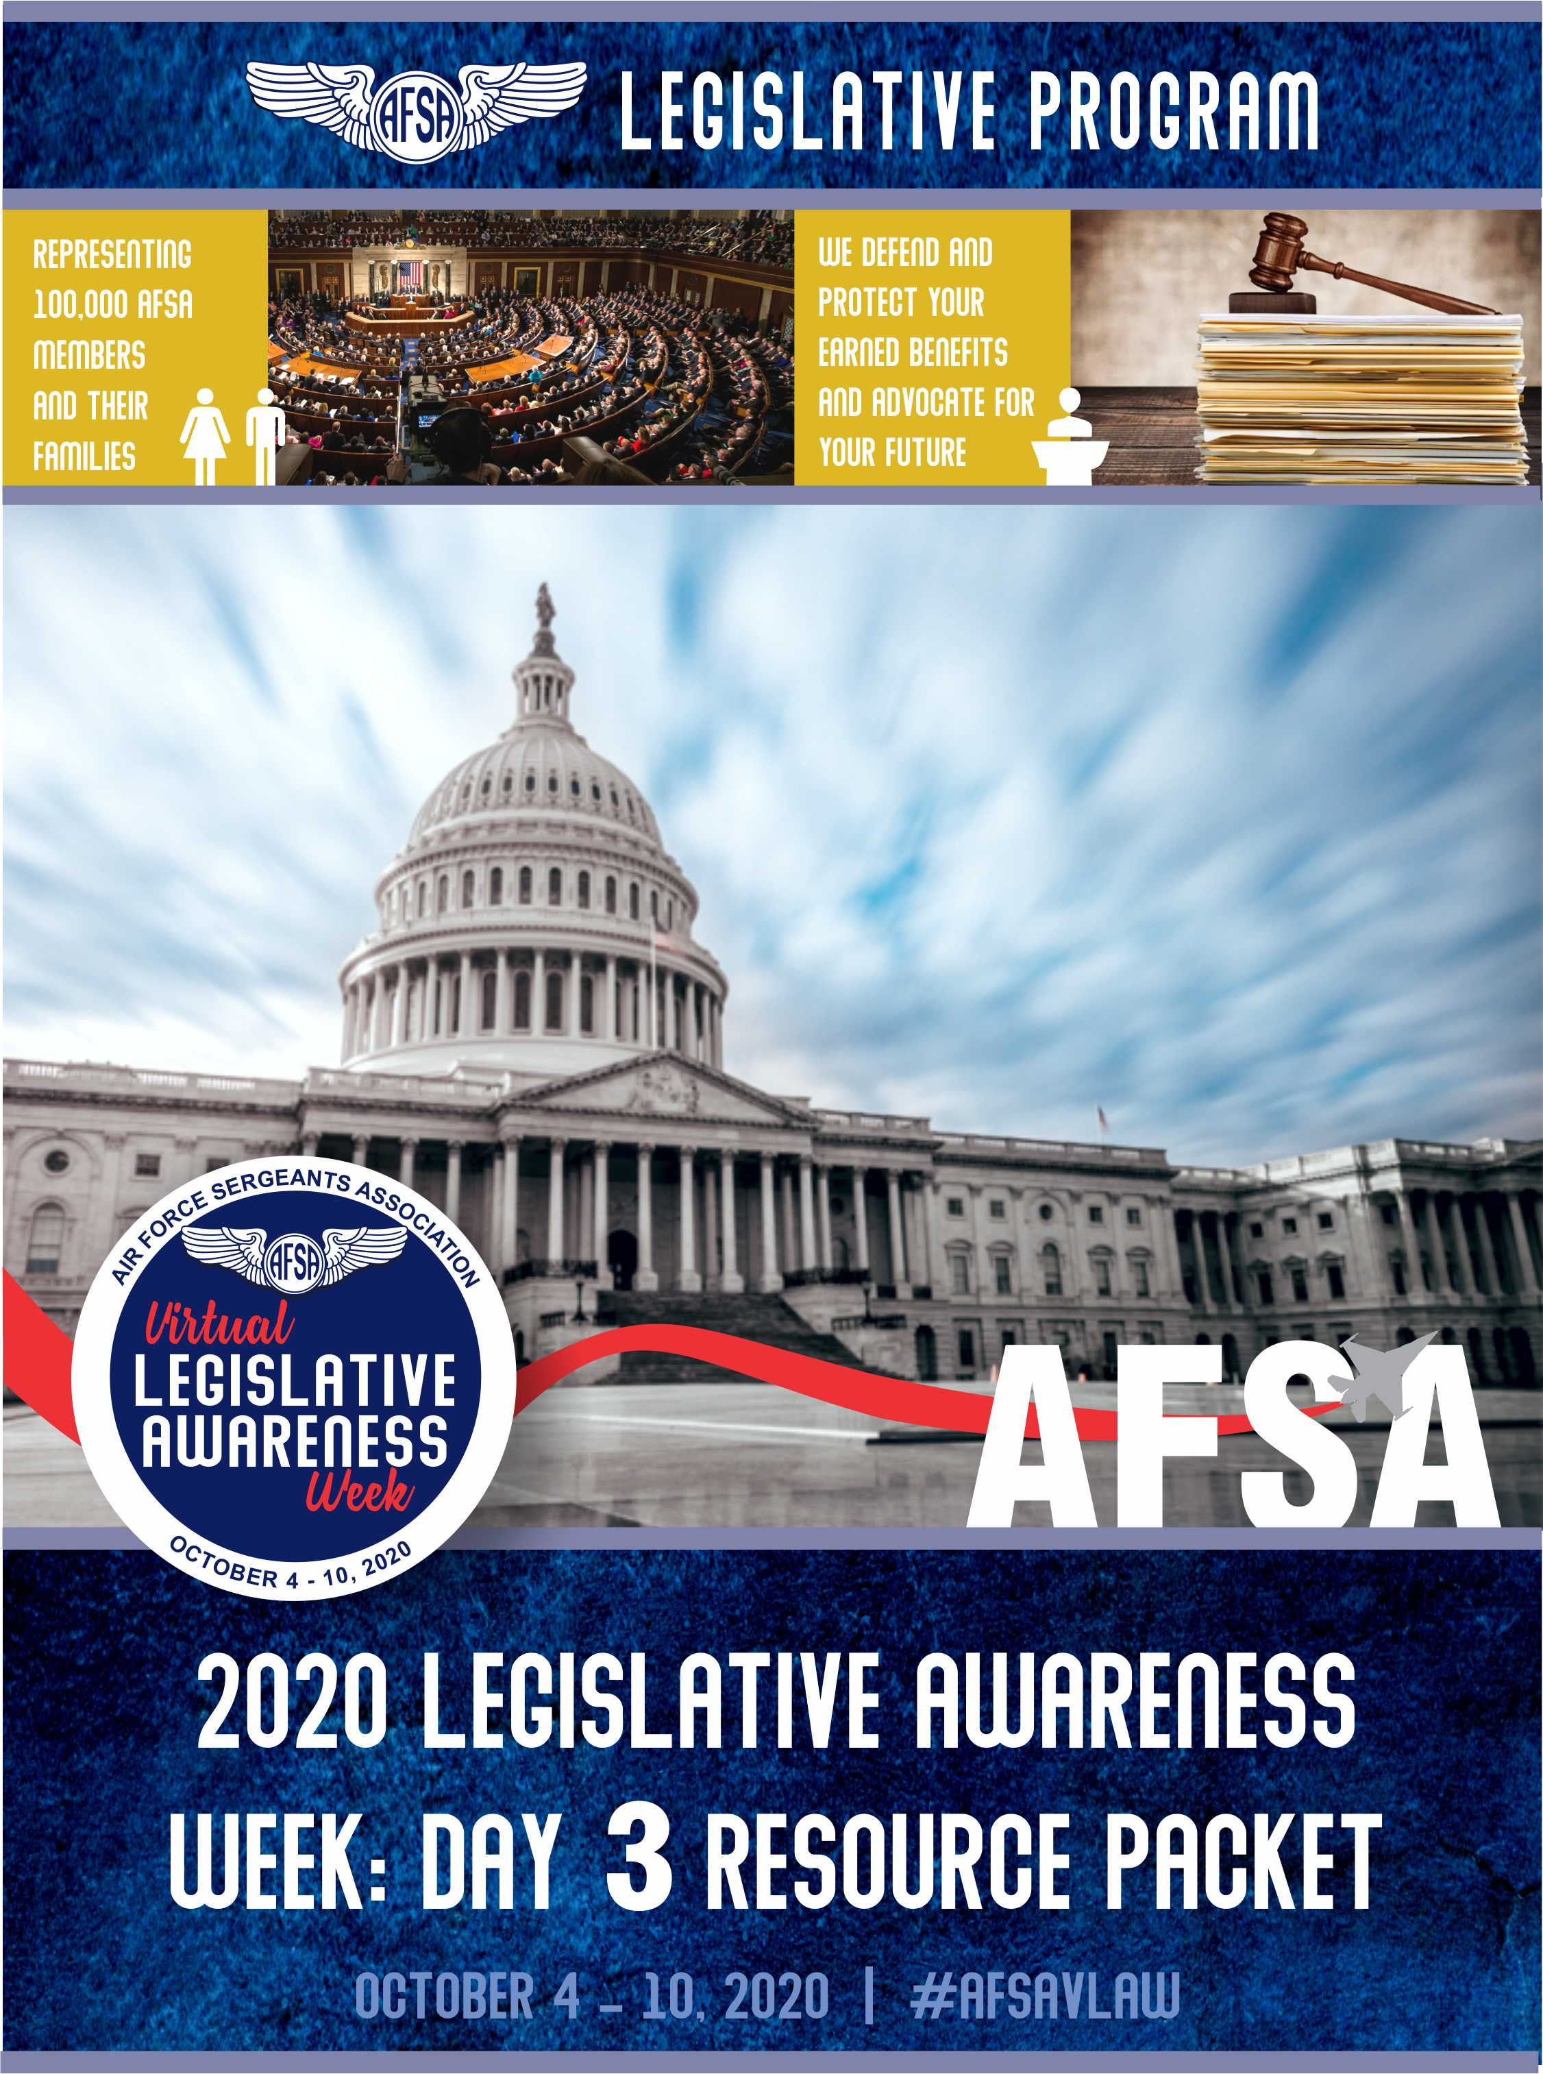
Tuesday “Military Healthcare” Advocacy Day
Supporting the House's FY2021 NDAA; Section 715
This legislation is the modification to limitation on the realignment or reduction of military medical manning end strength.
Section 716
This legislation is the modifications to implementation plan for restructure or realignment of military medical treatment facilities.
For more information, please visit
To write your elected officials, please visit
https://www.votervoice.net/AFSA/campaigns/77470/respond

Slide 16
Tuesday “Military Healthcare” Advocacy Day
Opposing TRICARE Select Enrollment Fees
This advocacy campaign will be calling for the opposition of the TRICARE Select enrollment fee and in support of extending the reinstatement period from three months to one year to ensure no one loses their healthcare coverage during this unprecedented time.
For more information, please visit
To write your elected officials, please visit
https://www.votervoice.net/AFSA/campaigns/77471/respond

Slide 17
Tuesday “Military Healthcare” Advocacy Day
Supporting H.R.6573
This legislation would authorize the Secretary of Defense to temporarily waive cost-sharing amounts under the TRICARE pharmacy benefits program during certain declared emergencies.
For more information, please visit
To write your elected officials, please visit
https://www.votervoice.net/AFSA/campaigns/77472/respond

Slide 18
Tuesday “Military Healthcare” Advocacy Day
Supporting S. 3979
This legislation would authorize the Secretary of Defense to temporarily waive cost-sharing amounts under the TRICARE pharmacy benefits program during certain declared emergencies.
To write your elected officials, please visit
https://www.votervoice.net/AFSA/campaigns/77473/respond

Slide 19
Wednesday “Suicide Prevention and Mental Healthcare” Advocacy Day
Supporting H.R.4370
This legislation requires the Department of Veterans Affairs to furnish hyperbaric oxygen therapy through a provider authorized by the Veterans Community Care Program to veterans who have a traumatic brain injury or post-traumatic stress disorder.
To write your elected officials, please visit
https://www.votervoice.net/AFSA/campaigns/77474/respond
Supporting S. 2504
This legislation requires the Department of Veterans Affairs to furnish hyperbaric oxygen therapy through a provider authorized by the Veterans Community Care Program to veterans who have a traumatic brain injury or post-traumatic stress disorder.
https://www.votervoice.net/AFSA/campaigns/77475/respond

Slide 20
Friday “Concurrent Receipt Legislation” Advocacy Day
Supporting House Concurrent Receipt Legislation
This legislation modifies provisions related to military retired pay. Specifically, the bill authorizes veterans with a service-connected disability of less than 50% to concurrently receive both retired pay and disability compensation.
For more information, please visit
To write your elected officials, please visit
https://www.votervoice.net/AFSA/campaigns/77476/respond

Slide 21
Friday “Concurrent Receipt Legislation” Advocacy Day
Supporting Senate Concurrent Receipt Legislation
Amending title 10, United States Code, to permit certain retired members of the uniformed services who have a service-connected disability to receive both disability compensation from the Department of Veterans Affairs for their disability and either retired pay by reason of their years of military service or Combat-Related Special Compensation
For more information, please visit
To write your elected officials, please visit
https://www.votervoice.net/AFSA/campaigns/77478/respond

Slide 22
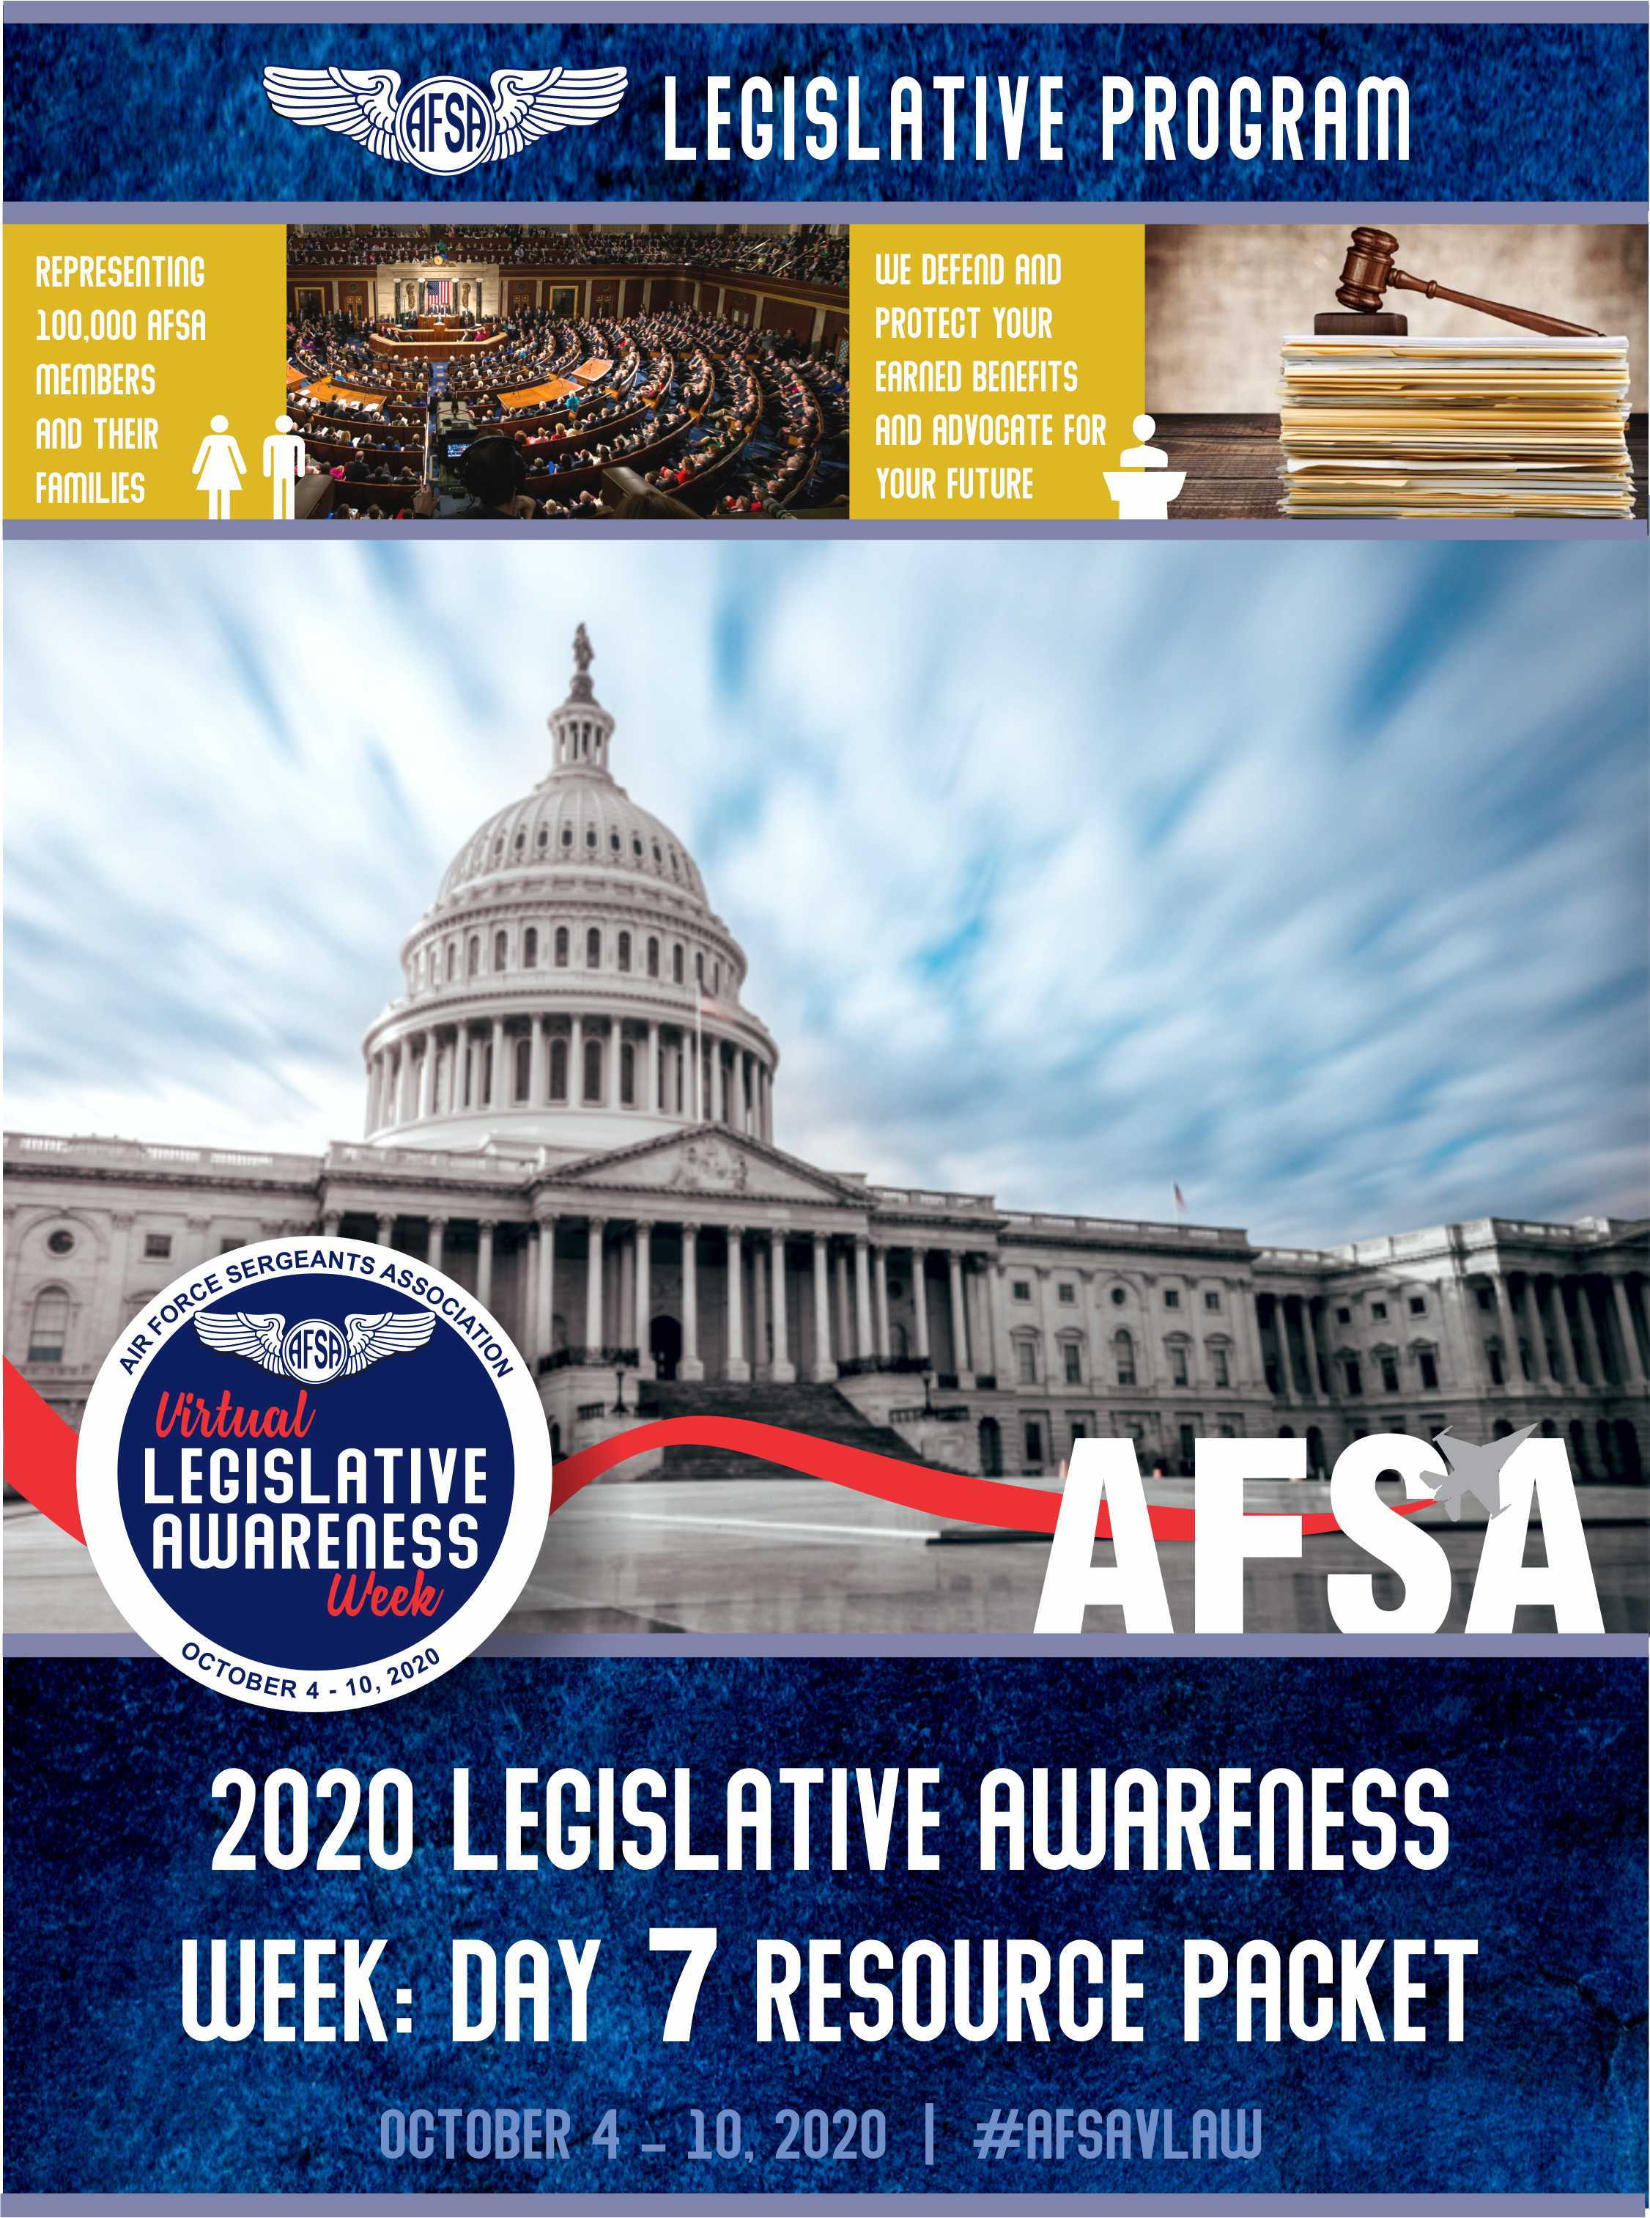
Saturday “Toxic Exposure and Agent Orange Healthcare” Advocacy Day
Supporting S. 4393
This legislation would improve the provision of health care and other benefits from the Department of Veterans Affairs for veterans who were exposed to toxic substances, and for other purposes.
To write your elected officials, please visit
https://www.votervoice.net/AFSA/campaigns/77479/respond

Slide 23
Saturday “Toxic Exposure and Agent Orange Healthcare” Advocacy Day
Supporting H.R.5610
This legislation provides a presumption of service-connection for Parkinsonism, bladder cancer, hypertension, and hypothyroidism for veterans exposed to certain herbicide agents while serving in Vietnam. Under a presumption of service-connection, specific conditions diagnosed in certain veterans are presumed to have been caused by the circumstances of their military service. Health care benefits and disability compensation may then be awarded.
To write your elected officials, please visit
https://www.votervoice.net/AFSA/campaigns/77481/respond

Slide 24
AFSA LEGISLATIVE ACCOMPLISHMENTS 2019
Veterans Benefits/Healthcare
Monitored the successful implementation of the new VA Appeals Process, Veterans Community Care Program and Urgent Care Benefit
Extended VA disability benefits covering medical conditions associated with Agent Orange exposure to those who served on ships off the coast of Vietnam ("Blue Water" Navy veterans).
Authorize a cost-of-living adjustment for disable veterans and/or their eligible survivors
Education
Reduced the credit hour requirement for the Edith Nourse Rogers STEM Scholarship program.
Made it simpler for permanent and totally disabled veterans to discharge their student loans.
Guard and Reserve
Extended bankruptcy protections for Guard and Reserve members who serve for at least 90 days on active duty.
Active/Reserve Force Issues
Finalize the 3.1% military pay raise
Implement BAH protections/enhancements
Direct improvements to the Transition Assistance Program
Provide paid family leave for Federal employees covered by title 5
Establish a basic needs allowance for low-income regular members
Military Spouses/ Families
Expand the My Career Advancement Account (MyCAA) program for military spouses to non-portable career fields and occupations
Modify current authority to reimburse for State licensure and certification costs of a spouse of a member arising from relocation from $500 to $1000
Repeal the “Military Widows tax”
Guarantee residency for spouses of members of uniformed services

Slide 25
Interact with us
www.hqafsa.org
@AFSAHQ
Air Force Sergeants Association

