Slide 1
AFSA Website New Retainer Form Process
March 2015 – IVP Tim Litherland (Updated August 2015)

Slide 2
HQs AFSA migrated to a new web platform in January 2015
AFSA’s website address did not change: www.hqafsa.org The new retainer form greatly enhances security but altered our online renewal process The following screenshots & explanations will walk retainers through the new retainer form process

Slide 3
Getting Started Go to HQ’s website at www.hqafsa.org
Start by Logging In

Slide 4
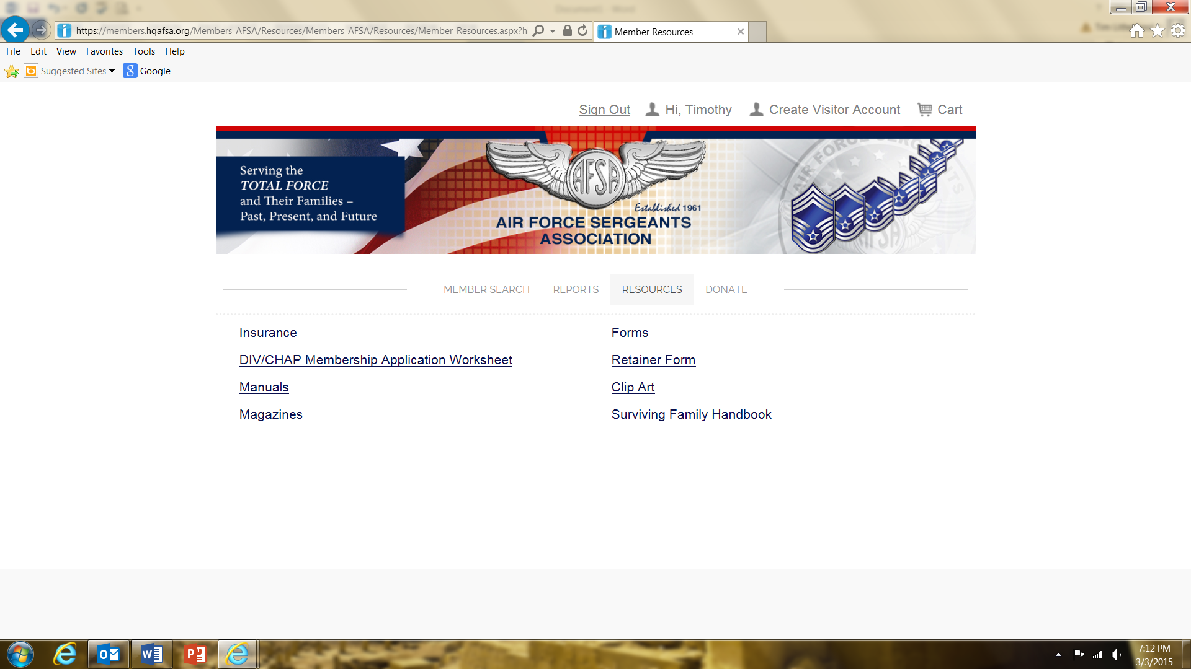
After logging in, select the Resources tab from your home screen to access the Retainer Form. The home screen shows your personal data, membership number, etc. You’ll see the window below after selecting the Resources tab.
The retainer form is a fillable pdf, you’ll need to save the form to your computer. If you need instructions or help saving the form, contact HQs
Update: HQs recently created an online retainer form so you NO longer have to save a pdf document to your home computer with sensitive renewing member credit or debit card information.
*Slides showing the online forms coming up after pdf version is explained.

Slide 5
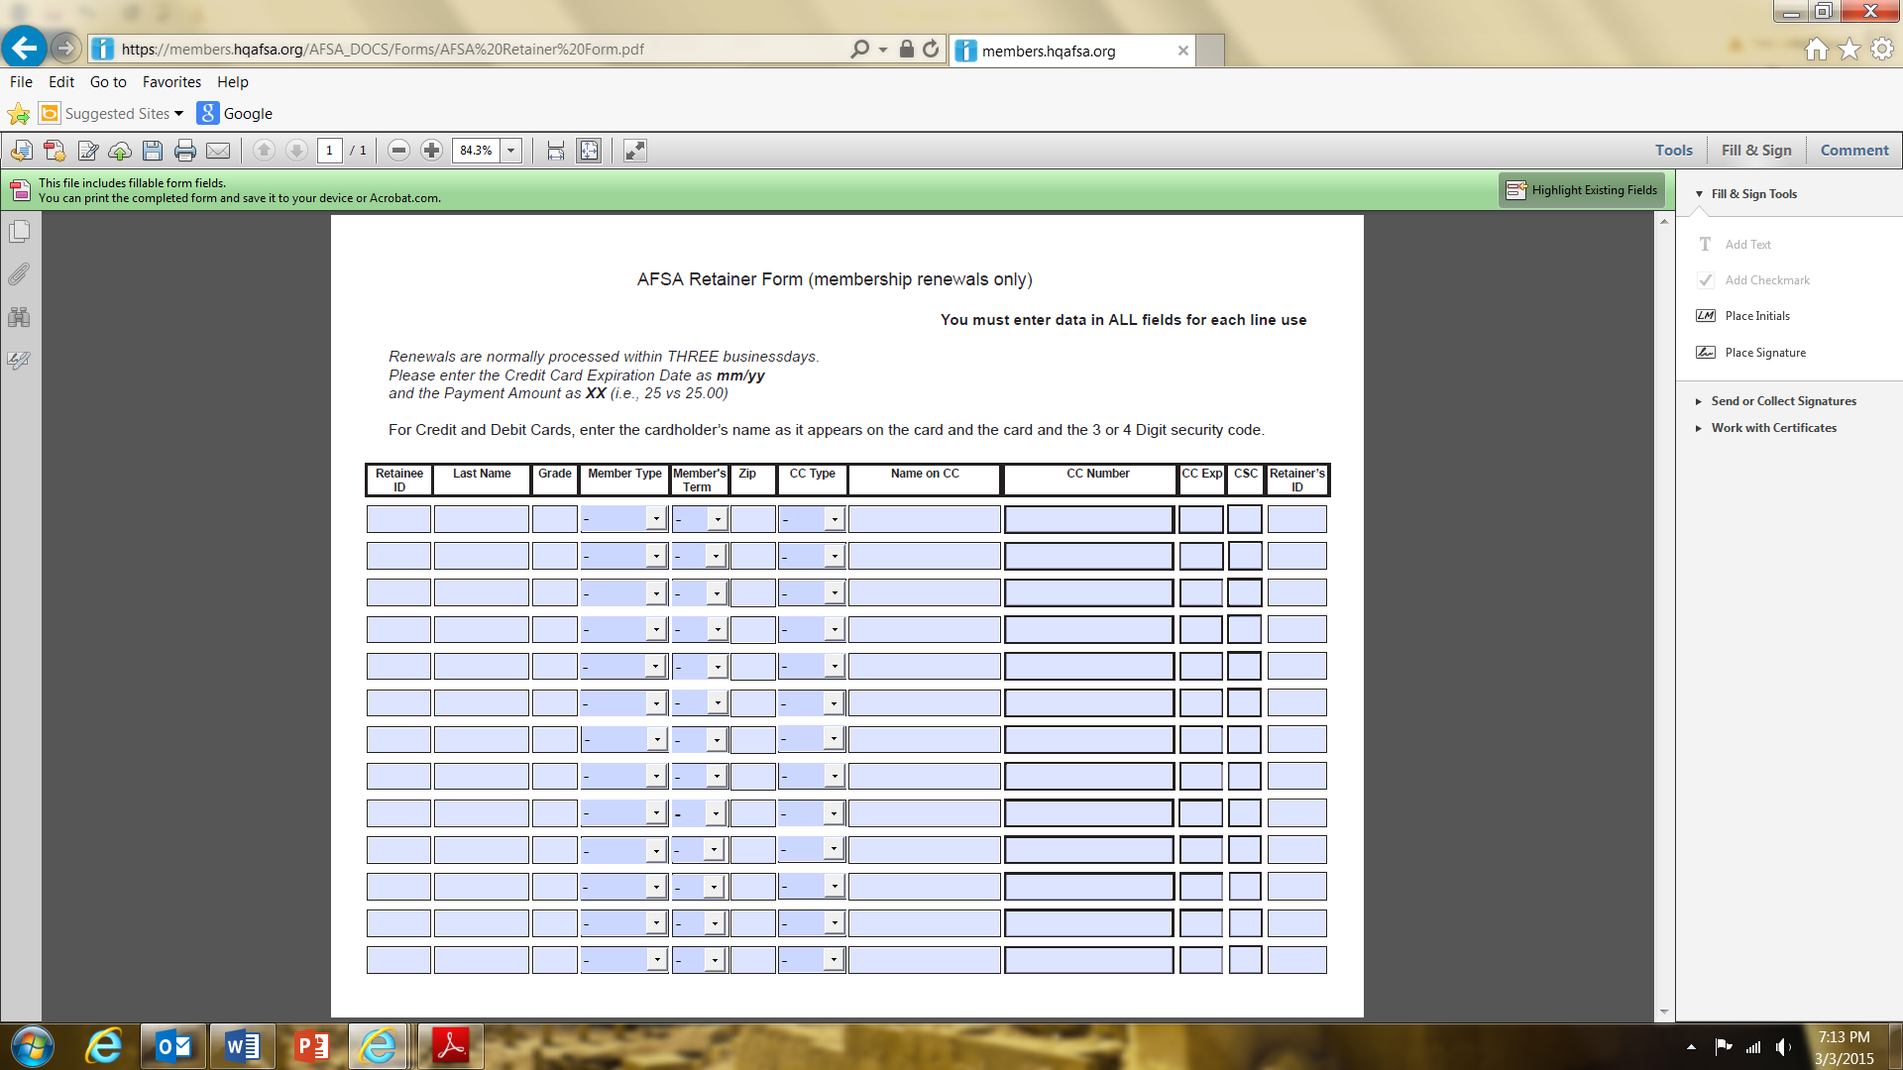
The new retainer form is a reusable document that’ll be stored on your computer. The old retainer form was basically an email that didn’t secure the renewing member's credit/debit card information. You’ll fill in the renewing member’s information, save the pdf on your computer then upload it to AFSA HQs via a secure connection on the website.
Complete the form, many blocks use dropdown select items. Ensure you include your membership number so you & your Chapter get retention credit.
IMPORTANT – Do NOT retain credit/debit card info after renewal completed.

Slide 6
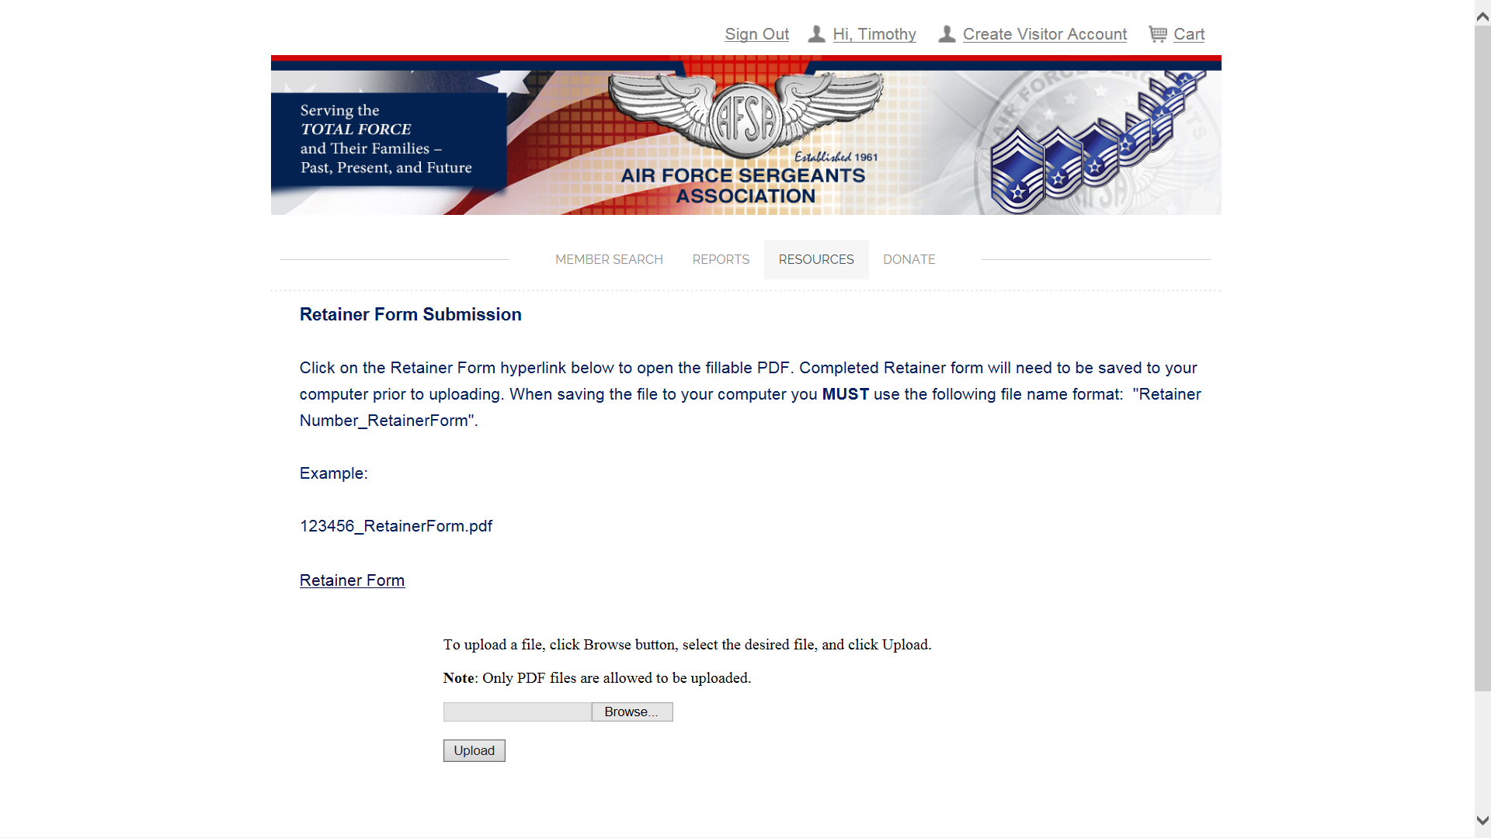
Note the required naming instructions below. Save the completed retainer form as a pdf (most computers will do this by default) on your computer using your member number, an underscore character and “RetainerForm”. Choose an easy to find location to save your retainer form like your desktop or create an AFSA folder in your Documents library.
Note required naming format

Slide 7
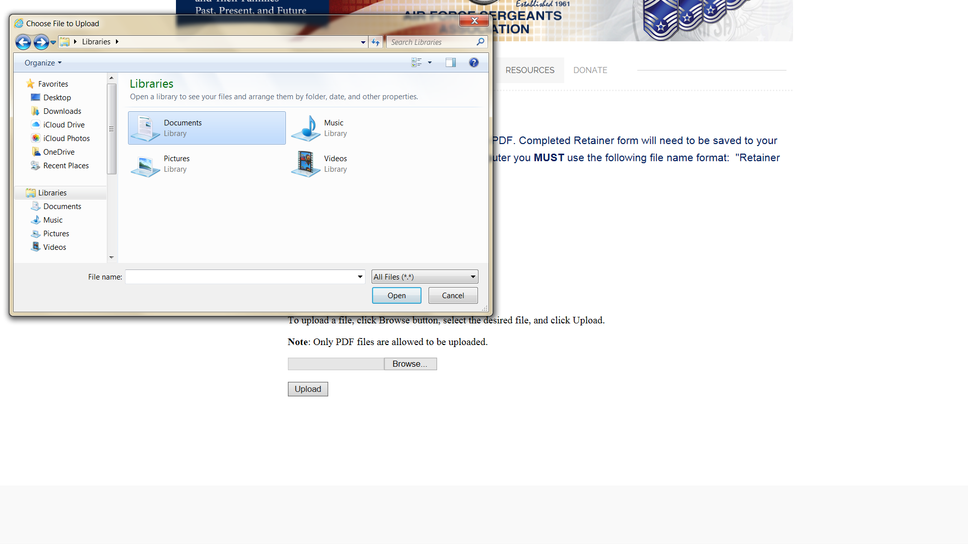
This screenshot shows a pop up window as the user browses to where they’ve saved their completed retainer form.
Click the Browse button to navigate to saved form

Slide 8
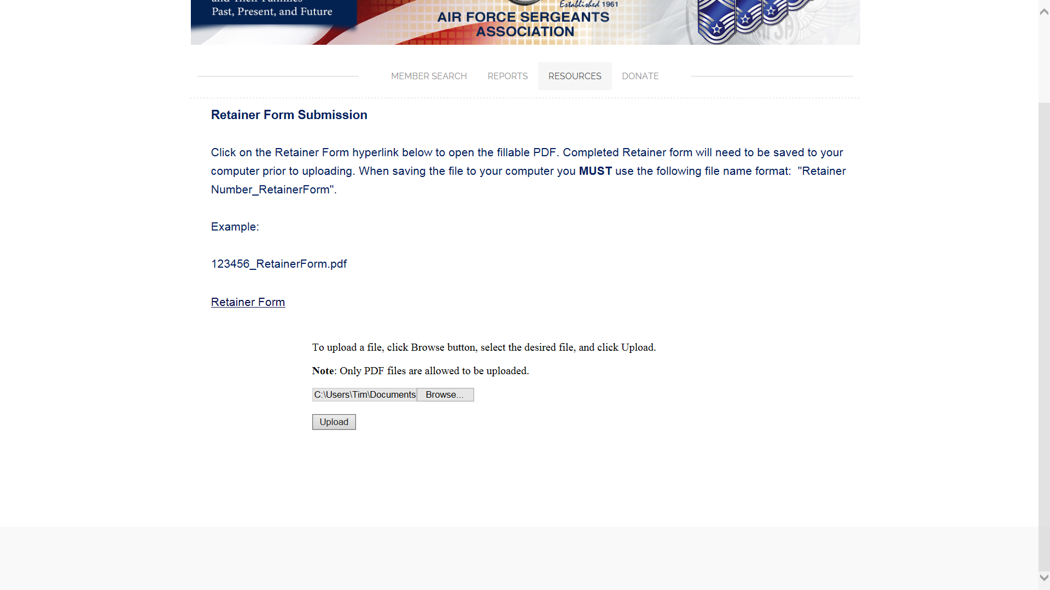
This screenshot shows the “Browse” process completed. Note the text in the “Browse” window below. The text gives directions to the website so it can find the completed retainer form to upload. DON’T FORGET…hit the Upload button.

Slide 9
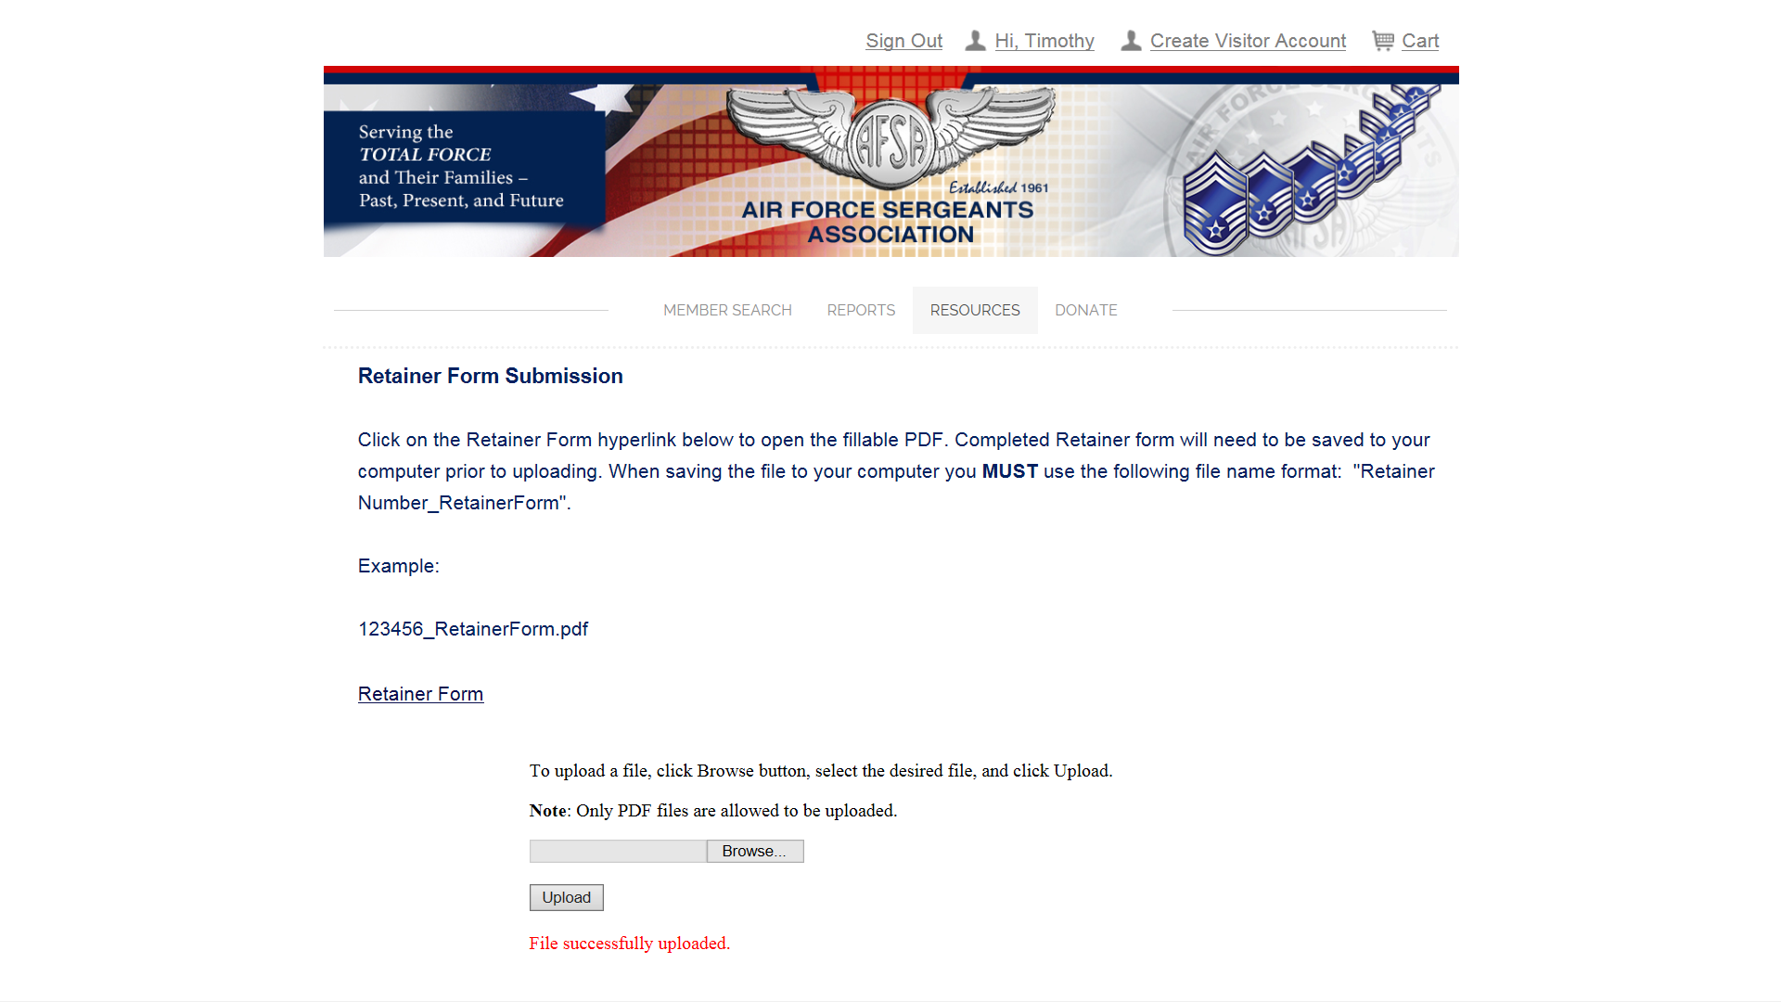
This screenshot shows a successful retainer form upload. Unlike the old process, the retainer does NOT get a confirmation email when a form is submitted. HQs will process the retainer form within three business days.
Form upload successful

Slide 10
Update: HQs recently updated the “Recruiter/Retainer Tools” under the Resources tab. You must login to access this part of the website. There are additional tools here to allow you to sign up multiple new members at once and uploadable membership and retainer forms. Go explore the site and these tools!
“How to” slide shows
Click links to access forms & help info

Slide 11
Update: This screenshot shows the next window after selecting “Retainer Form” on the last screenshot. Note the “New” Retainer Web Form and Retainer Web Form Worksheet at the bottom on the screen.
Great new tools, you can update changes & renew or just renew if the member has no address, etc changes

Slide 12
NEW: This slide shows part of the Membership Renewal with changes web form that appears after clicking the Retainer Web Form link. Complete the fields and hit the Submit button (no shown on this slide). HQs will update the renewing member’s address, email, phone number, etc when processing the renewal.

Slide 13
NEW: This window appears after selecting the “Retainer Web Form Worksheet” link. Complete this form like you would the pdf Retainer Form worksheet. Note the “Add Row” button. Once all retentions are completed, select the “Save Form” button. HQs will update the retentions within three business days. Nothing is saved to your computer when using the web form.

Slide 14
Final Thoughts New retainer form process greatly enhances security. VERY important to always safeguard THEN DELETE renewing member’s credit/debit card data. Don’t store card information on your computer IF using the pdf retainer form. Reuse the form BUT delete the card data. Retainers can always call AFSA HQs at 1-301-899-3500 x288 to renew their members or they can send their renewal applications to HQs via snail mail.

