Slide 1
Using the AFSA Website to Join New Members
1 March 2015 – IVP Tim Litherland (Aug 15 Update)

Slide 2
HQs AFSA migrated to a new web platform in January 2015
AFSA’s website address did not change: www.hqafsa.org
New web form altered our online membership sign up process
The following screen shots & explanations will walk recruiters through the new join process

Slide 3
Getting Started Go to HQ’s website at www.hqafsa.org
Recruiters don’t login, click the “Join AFSA Now” button

Slide 4
Select the membership type by clicking a picture.
See AFSA Manual
100-1, Bylaws for additional information on membership types

Slide 5
The Membership Verification screen is new. This process will check if the person wishing to join is already a member or an Inactive member whose membership reactivation must be called into HQs

Slide 6
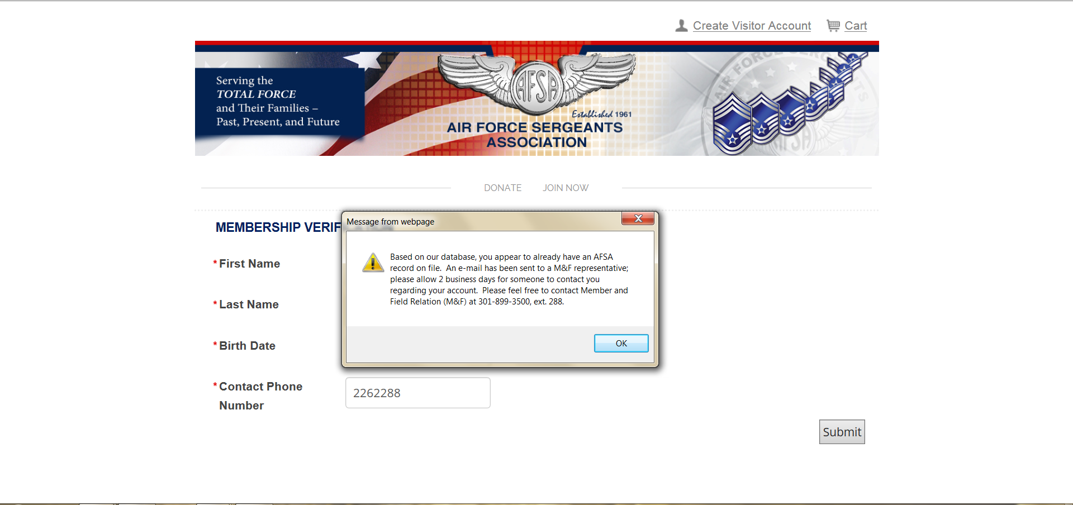
This is a screenshot of the “Already a member ” message. A membership “reactivation” must be called into AFSA HQs. A reactivated member will keep their old membership number using this process.
Notes:
This process is not fool proof. If the “new” member's name is misspelled, they may pass the verification resulting in a duplicate membership record. These type of database errors will be caught by our quality assurance process. Refunds or a membership term extensions will be worked on a one to one basis.

Slide 7
Update: This screenshot shows the new failed “Membership Verification Check” link. Instead of calling AFSA HQs to “rejoin”, the returning member or their recruiter can click the link and complete the application process. The “parked” secure web form will be updated by HQs on the next business day.
New rejoin link
Notes:
This process is not fool proof. If the “new” member's name is misspelled, they may pass the verification resulting in a duplicate membership record. These type of database errors will be caught by our quality assurance process. Refunds or a membership term extensions will be worked on a one to one basis.

Slide 8
If HQs database doesn’t show any past membership data on the new recruit the “Enter Personal Information” page will appear.
Always use a U.S. mailing address, particularity important overseas—don’t use a foreign mailing address

Slide 9
This is the bottom half of the “Enter Personal Information” page.
Important – include your membership ID to get credit for you & your Chapter
Some email addresses may reject, see slide notes
Use drop down
Tech school or overseas base recruits
Active Duty AF, ANG, Reserve drop down
Active, Retired, etc
Also a new feature. Create User Name w first letter of first name, whole last name, birth month & year as two digit numbers. John Smith born in Apr 75 is: jsmith0475
Use password as the password
Notes:
Some members may reflect an email address on file. If this happens the application may reject with a “This email already appears to be in use” error message. Just add a number or letter to the address (new.member@gmail.com1 as an example) to get it to take and call HQs immediately to get the address corrected. A couple using the same “family” email address may also get this error.

Slide 10
This screen appears after completing the “Enter Personal Information” page
The Chapter will be automatic based on the new recruit’s zip code. You may use the drop down to select a different Chapter if desired
Select Membership Term and then Submit

Slide 11
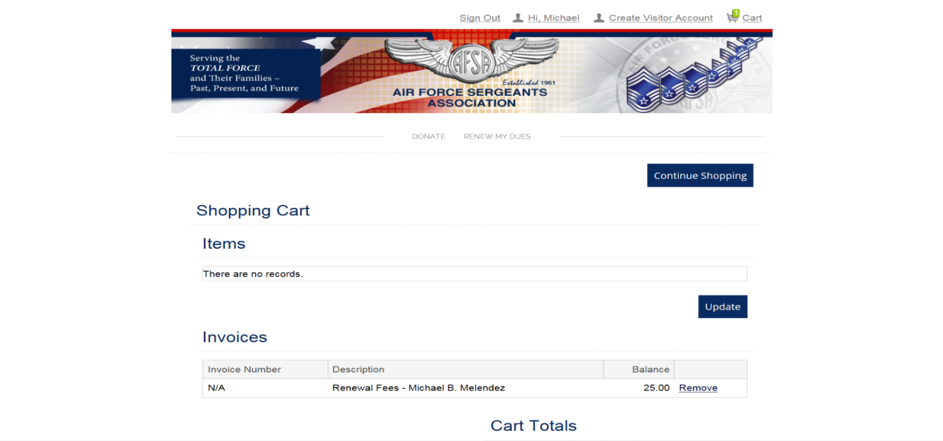
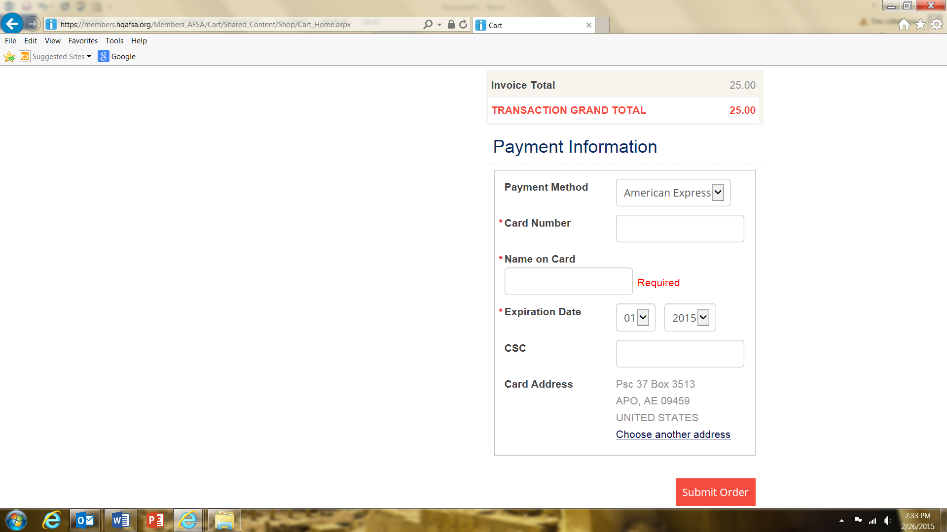
The “Shopping Cart” check-out screen appears after selecting the
Chapter assignment and membership term.
Recruit Name – Data Mask
NOTE: A Chapter may use a Chapter debit card if the recruit paid in cash. The recruiter may use their own debit card for the same reason. Provide a receipt of some type to show payment.
If making a card payment, click the “Choose another address” link to update the card billing address.
Data Mask

Slide 12
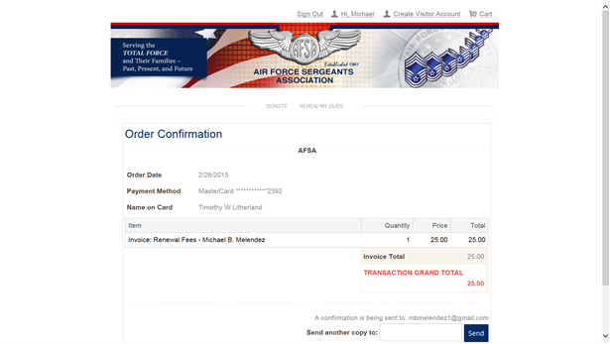
This the final screen of the Join process. Assuming no debit or credit card problems, the screen will refresh and a “Welcome” message will appear. Log your new recruit out. The new member will also get a welcome email and receipt. Login to the HQs website and check that the recruit was credited to you. You’ll be able to see the new recruit’s Membership number there. HQs will mail the new member their membership card along with the user name and password you set up for them with instructions on how to change their password.
Data mask
Data mask
Data mask

Slide 13
Update: HQs recently updated the “Recruiter/Retainer Tools” under the Resources tab. You must login to access this part of the website. There are additional tools here to allow you to sign up multiple new members at once and unloadable membership and retainer forms. Go explore the site and these tools!
“How to” slide shows
Click links to access forms & help info

Slide 14
Final Thoughts A bit different from the old website join process--most things are similar. Recruiters can of course always call AFSA HQs at 1-800-638-0594 to sign their recruits up or can send membership applications to HQs via mail. Recent updates provide recruiters/retainers additional ways to sign up and renew people.

